Slide 1
Narcovet
Giulia Bleichenbacher
Sarah Deckarm
Leonie Isele
Firat Turan
The solution for automated management of narcotics in veterinary practice

Slide 2
The problem we tackle:
Narcotics require strict documentation
Often no automation and paper based
No clear path of communication
No clear responsibilities defined

Slide 3
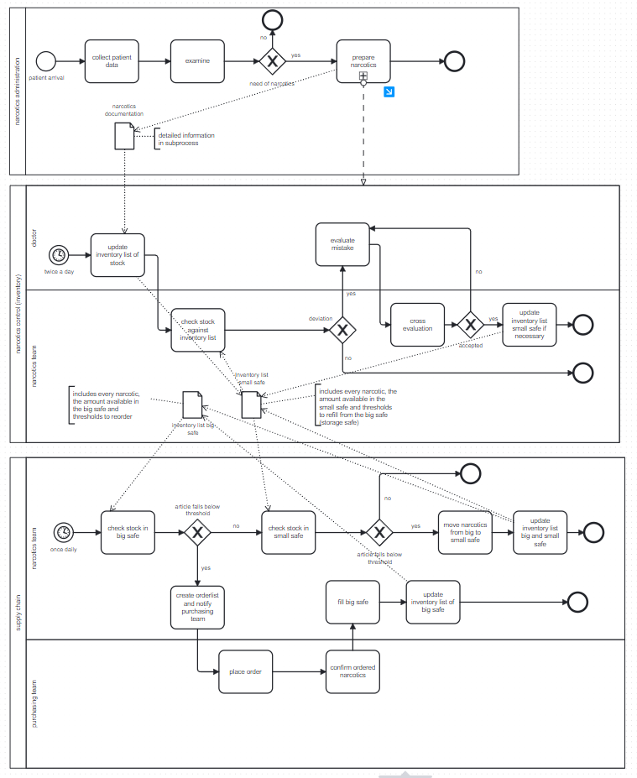
AS IS Process

Slide 4
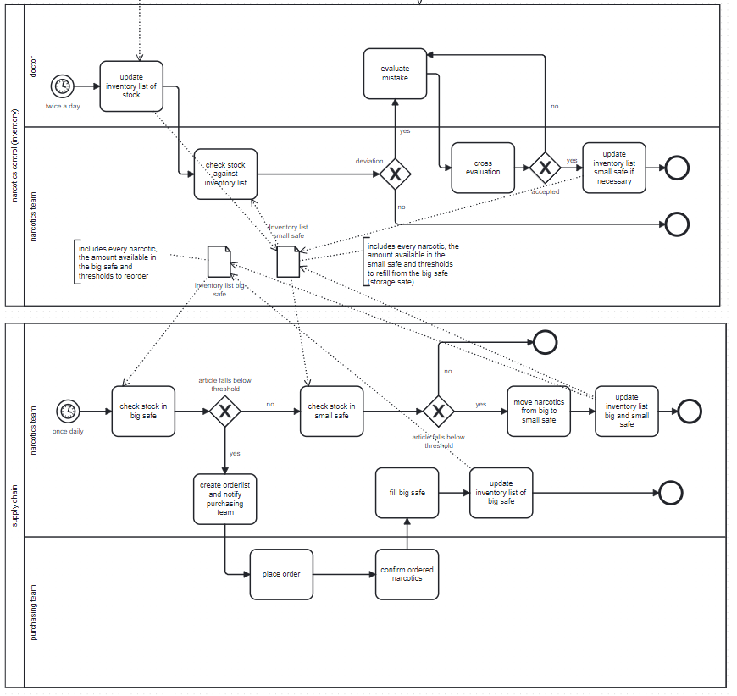
AS IS Process – main process of interest

Slide 5
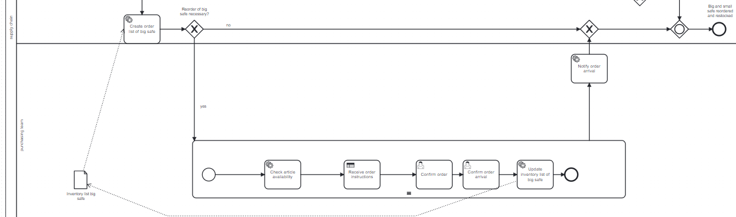
TO BE Process

Slide 6
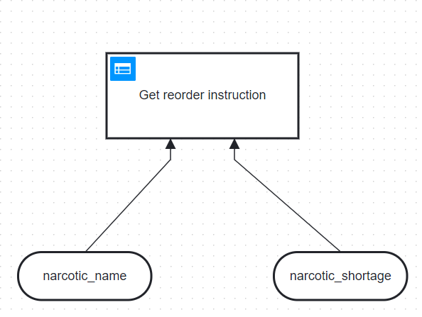
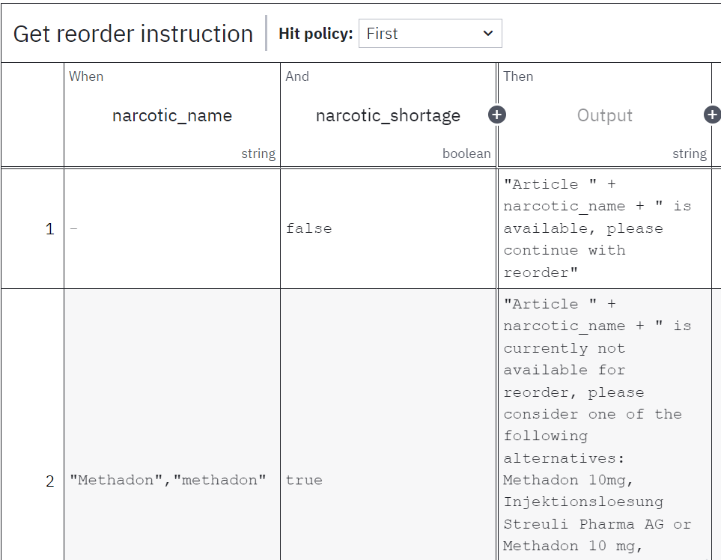
TO BE Process

Slide 7
The solution we provide
talking about technical details
Automation:
inventory is checked as time event automatically
Returns if threshold is under orover limit
placeholder
Unification:
Decision support:
use of Camunda, Python,
Multiple service tasks, Decision modeling

Slide 8
Demonstration
Let us show it to you in a video

Slide 9
Benefits
Narcotics management
Reduction of hours:
180h per year without Narcovets
67h per year with Narcovets
Reduction of expenses:
10.000CHF per year without Narcovets
5.000CHF per year with Narcovets
Cherry on top:
Centralized documentation
Less risk for human errors or human intervention for misuse

Slide 10
Conclusion
Problems
Solutions
Exlusively paper based
No automation
Unclear responsibilities
Time consuming
No decision support for alternative medications
Inventory list: digitalized
Automated e-mail generation
For order arrival
Threshold warning
Decision logic implemented to enable quick access to alternative medications

